Slide 1
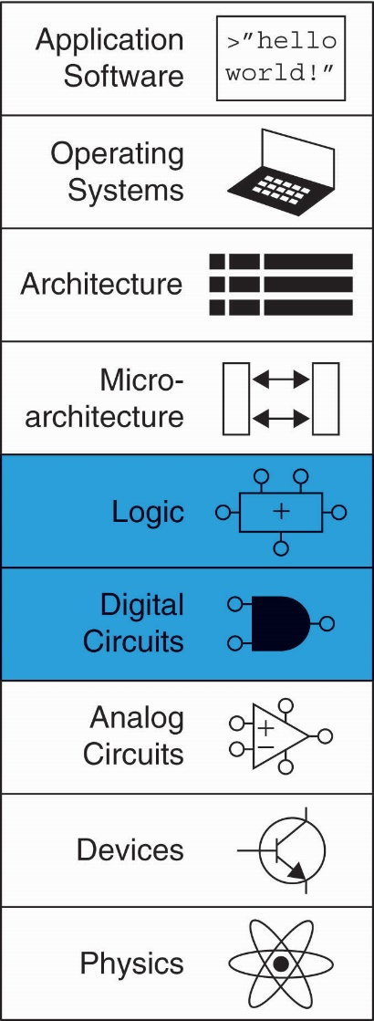
Chapter 4 :: Topics
Introduction
Combinational Logic
Structural Modeling
Sequential Logic
More Combinational Logic
Finite State Machines
Parameterized Modules
Testbenches

Slide 2
Introduction
Hardware description language (HDL):
specifies logic function only
Computer-aided design (CAD) tool produces or synthesizes the optimized gates
Most commercial designs built using HDLs
Two leading HDLs:
SystemVerilog
developed in 1984 by Gateway Design Automation
IEEE standard (1364) in 1995
Extended in 2005 (IEEE STD 1800-2009)
VHDL 2008
Developed in 1981 by the Department of Defense
IEEE standard (1076) in 1987
Updated in 2008 (IEEE STD 1076-2008)

Slide 3
HDL to Gates
Simulation
Inputs applied to circuit
Outputs checked for correctness
Millions of dollars saved by debugging in simulation instead of hardware
Synthesis
Transforms HDL code into a netlist describing the hardware (i.e., a list of gates and the wires connecting them)

Slide 4
HDL to Gates
Simulation
Inputs applied to circuit
Outputs checked for correctness
Millions of dollars saved by debugging in simulation instead of hardware
Synthesis
Transforms HDL code into a netlist describing the hardware (i.e., a list of gates and the wires connecting them)
IMPORTANT: When using an HDL, think of the hardware the HDL should produce

Slide 5
SystemVerilog Modules
Two types of Modules:
Behavioral: describe what a module does
Structural: describe how it is built from simpler modules

Slide 6
Behavioral SystemVerilog
SystemVerilog:
module example(input logic a, b, c,
output logic y);
assign y = ~a & ~b & ~c | a & ~b & ~c | a & ~b & c;
endmodule

Slide 7
Behavioral SystemVerilog
SystemVerilog:
module example(input logic a, b, c,
output logic y);
assign y = ~a & ~b & ~c | a & ~b & ~c | a & ~b & c;
endmodule
module/endmodule: required to begin/end module
example: name of the module
Operators:
~: NOT
&: AND
|: OR

Slide 8
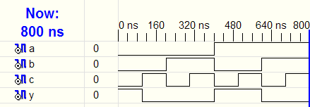
HDL Simulation
SystemVerilog:
module example(input logic a, b, c,
output logic y);
assign y = ~a & ~b & ~c | a & ~b & ~c | a & ~b & c;
endmodule

Slide 9
HDL Synthesis
SystemVerilog:
module example(input logic a, b, c,
output logic y);
assign y = ~a & ~b & ~c | a & ~b & ~c | a & ~b & c;
endmodule
Synthesis:

Slide 10
SystemVerilog Syntax
Case sensitive
Example: reset and Reset are not the same signal.
No names that start with numbers
Example: 2mux is an invalid name
Whitespace ignored
Comments:
// single line comment
/* multiline
comment */

Slide 11
Structural Modeling - Hierarchy
module and3(input logic a, b, c,
output logic y);
assign y = a & b & c;
endmodule
module inv(input logic a,
output logic y);
assign y = ~a;
endmodule
module nand3(input logic a, b, c
output logic y);
logic n1; // internal signal
and3 andgate(a, b, c, n1); // instance of and3
inv inverter(n1, y); // instance of inv
endmodule

Slide 12
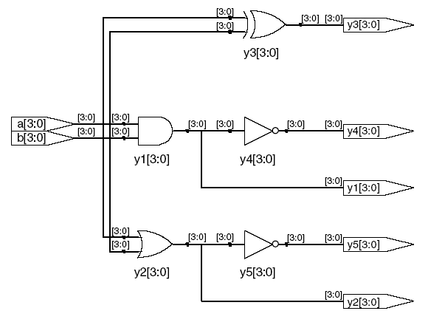
Bitwise Operators
module gates(input logic [3:0] a, b,
output logic [3:0] y1, y2, y3, y4, y5);
/* Five different two-input logic
gates acting on 4 bit busses */
assign y1 = a & b; // AND
assign y2 = a | b; // OR
assign y3 = a ^ b; // XOR
assign y4 = ~(a & b); // NAND
assign y5 = ~(a | b); // NOR
endmodule
// single line comment
/*…*/ multiline comment

Slide 13
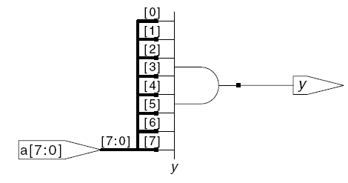
Reduction Operators
module and8(input logic [7:0] a,
output logic y);
assign y = &a;
// &a is much easier to write than
// assign y = a[7] & a[6] & a[5] & a[4] &
// a[3] & a[2] & a[1] & a[0];
endmodule

Slide 14
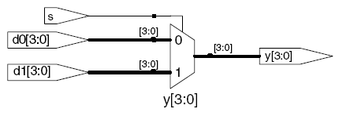
Conditional Assignment
module mux2(input logic [3:0] d0,
logic [3:0] d1,
input logic s,
output logic [3:0] y);
assign y = s ? d1 : d0;
endmodule
? : is also called a ternary operator because it
operates on 3 inputs: s, d1, and d0.

Slide 15
Internal Variables
module fulladder(input logic a, b, cin,
output logic s, cout);
logic p, g; // internal nodes
assign p = a ^ b;
assign g = a & b;
assign s = p ^ cin;
assign cout = g | (p & cin);
endmodule

Slide 16
Precedence
Highest
~ | NOT
*, /, % | mult, div, mod
+, - | add,sub
<<, >> | shift
<<<, >>> | arithmetic shift
<, <=, >, >= | comparison
==, != | equal, not equal
&, ~& | AND, NAND
^, ~^ | XOR, XNOR
|, ~| | OR, NOR
?: | ternary operator
Lowest

Slide 17
Numbers
Format: N'Bvalue
N = number of bits, B = base
N'B is optional but recommended (default is decimal)
Number | # Bits | Base | Decimal Equivalent | Stored
3'b101 | 3 | binary | 5 | 101
'b11 | unsized | binary | 3 | 00…0011
8'b11 | 8 | binary | 3 | 00000011
8'b1010_1011 | 8 | binary | 171 | 10101011
3'd6 | 3 | decimal | 6 | 110
6'o42 | 6 | octal | 34 | 100010
8'hAB | 8 | hexadecimal | 171 | 10101011
42 | Unsized | decimal | 42 | 00…0101010
Notes:
Fine lezione 10

Slide 18
Bit Manipulations: Example 1
assign y = {a[2:1], {3{b[0]}}, a[0], 6'b100_010};
// if y is a 12-bit signal, the above statement produces:
y = a[2] a[1] b[0] b[0] b[0] a[0] 1 0 0 0 1 0
// underscores (_) are used for formatting only to make
// it easier to read. SystemVerilog ignores them.
Y[0]=1’b1;
Y[1] = 1’b0;

Slide 19
Bit Manipulations: Example 2
SystemVerilog:
module mux2_8(input logic [7:0] d0, d1,
input logic s,
output logic [7:0] y);
mux2 lsbmux(d0[3:0], d1[3:0], s, y[3:0]);
mux2 msbmux(d0[7:4], d1[7:4], s, y[7:4]);
endmodule

Slide 20
Z: Floating Output
SystemVerilog:
module tristate(input logic [3:0] a,
input logic en,
output tri [3:0] y);
assign y = en ? a : 4'bz;
endmodule

Slide 21
SystemVerilog logic datatype
SystemVerilog logic datatype can assume 0, 1, z, and x values.
x indicates an invalid logic level. If a bus is simultaneously driven to 0 and 1 by two enabled tristate buffers (or other gates), the result is x, indicating contention.
If all the tristate buffers driving a bus are simultaneously OFF, the bus will float, indicated by z.
At the start of simulation, state nodes such as flip-flop outputs are initialized to an unknown state (x in SystemVerilog)

